Slide 1

Data Analysis Essentials
Cornerstone Project
Web Scraping & Product Price Analysis
E-Commerce | Amazon India AC Listings
Presented by
M. Akshaya (25B11CS608)
P. Jagannadha Veera Manikanta (25B11CS710)
K. Sai Krishna (25B11CS388)
T. Yeghna Surya Teja (25B11CS923)
Guide: Mr. K. Ashok Teja, Assistant Professor, CSE Dept.
Department of Computer Science and Engineering

Slide 2

PROBLEM STATEMENT
1
2
Scattered data
Prices, discounts and ratings sit on many different pages, so comparing ACs by hand is slow.
Buried details
Brand, tonnage, star rating, inverter and Wi-Fi are hidden inside long product titles.
3
4
Unreliable numbers
Some MRPs are wrong (selling price above MRP) and some values are missing, which distorts discounts.
Unclear price drivers
Buyers and sellers cannot tell which factors, such as tonnage, stars or Wi-Fi, really move the price.
Prices, discounts and ratings are scattered across many pages and are hard to compare by hand. We need automatic collection, cleaning and analysis.

Slide 3
OBJECTIVES
1
Scrape
Collect AC listings from Amazon India automatically: name, link, rating, number of ratings, price and MRP.
2
Filter and extract
Keep genuine listings with unique ASINs, then derive brand, tonnage, star rating, inverter and Wi-Fi from titles.
3
Clean and validate
Keep blanks, remove wrong MRPs and flag price outliers so the numbers can be trusted.
4
Analyse
Measure how price relates to brand, tonnage, star rating, features and discounts using correlation and group comparisons.
5
Visualise
Show the patterns in clear charts: distribution, brand averages, box plot, scatter plot and heatmap.
6
Advise
Turn the results into practical pricing and buying advice for sellers and buyers.

Slide 4
TOOLS & PIPELINE OVERVIEW
Tools and tech stack
Python 3
Pandas
NumPy
Matplotlib
Requests
BeautifulSoup
Regex (re)
Colab / Jupyter
GitHub
8-stage pipeline
1
2
3
4
Load & Read
Acquire & Filter
Extract
Validate & Clean
read_csv, describe
scraper + filters
regex on titles
blanks, MRP, IQR
5
6
7
8
Aggregate
Analyse
Visualise
Interpret
groupby, pivot
correlation, premiums
9 charts
key findings
Raw → Filtered → Extracted → Cleaned → Aggregated → Analysed → Visualised → Results

Slide 5
DATA COLLECTION
Source
Amazon India search for “air conditioner”
Method
Requests fetches pages; BeautifulSoup parses them
Fields
Name, link, rating, number of ratings, price, MRP
De-duplication
Duplicates removed by ASIN
Brand | Capacity / stars | Rating | No. of ratings | Price (Rs) | MRP (Rs)
Helium | 0.8 ton, 3 star | 3.3 | 212 | 22,990 | 40,100
IFB | 0.95 ton, 3 star | 4.4 | 200 | 30,990 | 50,990
Hitachi | 1.5 ton, 3 star | 4.1 | 478 | 36,500 | 63,990
Lloyd | 1.5 ton, 3 star | 3.7 | 308 | 34,990 | 56,990
LG | 0.8 ton, 2 star | 3.1 | 101 | 24,990 | 48,990
Sample of 5 of the 32 listings.

Slide 6
DATA LOADING & READING
Loading the product data into Pandas
1
2
3
CSV FILE
→
PANDAS
→
CHECK DATA
Our collected product details are saved in a CSV file.
Use Python’s Pandas library to read the CSV file.
View the first rows and column names to understand the data.
Simple Python example
import pandas as pd
df = pd.read_csv('Air_Conditioners_Raw.csv')
print(df.head())
Purpose: prepare the product data for analysis and interpretation.

Slide 7
CLEANING & VALIDATION
2
Blanks kept, never filled
1 missing price and 1 missing MRP stay empty. No median or mean filling, so averages and discounts are not distorted.
blanks kept
6
MRP check
Selling price above MRP is impossible (Blue Star: Rs 34,990 vs MRP Rs 17,495). Those MRPs were blanked, so discounts use 25 verified listings.
bad MRPs
3
Outliers flagged, not deleted
IQR rule: Q1 Rs 30,140, Q3 Rs 37,490, normal range Rs 19,115 to 48,515. Flagged: Oakter 0.5 Ton, Daikin 1.5 Ton 5-Star, Blue Star 2 Ton.
outliers
Also checked: 0 duplicate rows, 0 duplicate ASINs, 0 out-of-range values

Slide 8
DATASET SUMMARY
32
16
Rs 34,990
4.02
listings
brands
median price
average rating
Scraping
Data quality
Tools
Requests + BeautifulSoup on Amazon India "air conditioner" pages
3 to 7 s delay, 3 retries
Duplicates removed by ASIN
31 of 32 prices verified
25 verified discounts, average 40.3%
100% extraction of brand, tonnage, star
Pandas, NumPy, Matplotlib
Colab / Jupyter notebooks
Code and CSVs on GitHub
One-day snapshot of Amazon India listings

Slide 9
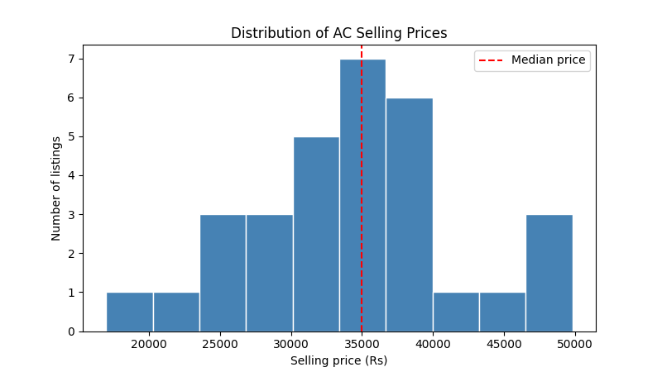
PRICE DISTRIBUTION
Most ACs cluster around the Rs 34,990 median
Rs 34,990
median selling price. Prices range from Rs 16,999 to Rs 49,804.

Slide 10
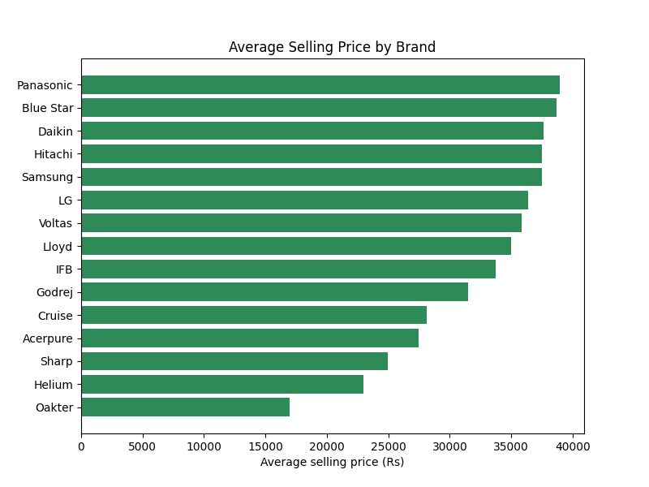
AVERAGE PRICE BY BRAND
Blue Star is priciest on average; Cruise is cheapest
Rs 38,694 vs Rs 28,140
Blue Star vs Cruise. Panasonic (Rs 38,990) and Oakter (Rs 16,999) have one listing each.

Slide 11
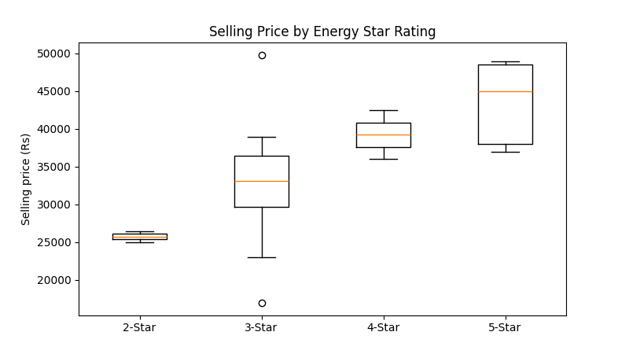
PRICE BY STAR RATING
Higher star ratings come with higher prices
Rs 43,494 vs Rs 32,798
average price of 5-star vs 3-star models.

Slide 12
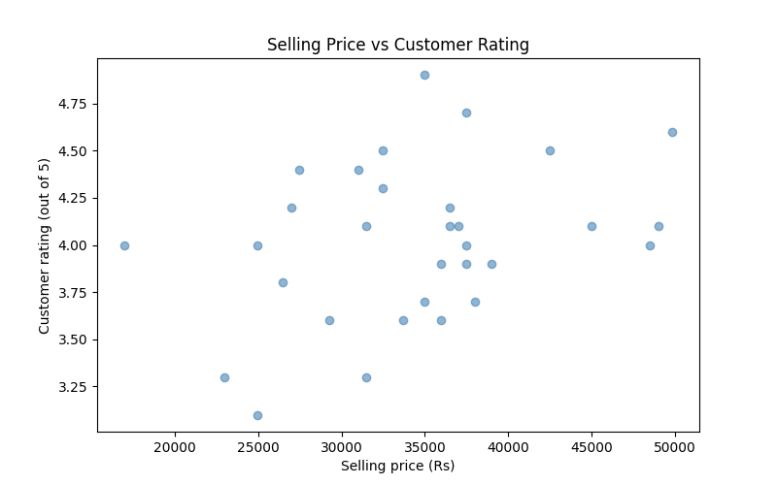
PRICE VS RATING
Price and customer rating are only weakly linked
r = 0.33
weak positive correlation. Higher price tends to go with slightly better ratings.

Slide 13
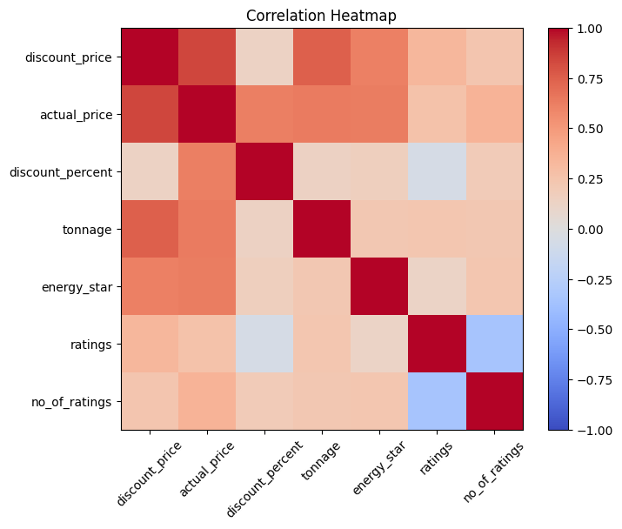
CORRELATION HEATMAP
Tonnage has the strongest link to price
r = 0.74
price vs tonnage. Energy-star rating also relates to price (r = 0.61).

Slide 14
KEY FINDINGS
r = 0.74
Price rises with tonnage
Rs 43,494
5-star average, vs Rs 32,798 for 3-star
Rs 37,573
Wi-Fi model average, vs Rs 33,741 without
40.3%
Average verified discount, across 25 listings
Blue Star
Priciest brand on average (Rs 38,694). Cruise is cheapest (Rs 28,140)
97%
of listings are inverter ACs

Slide 15
RESULTS & INTERPRETATION
What the results mean for buyers and sellers
BUYER ADVICE
SELLER ADVICE
Acerpure: Rs 18,327 per ton
Use competitor prices as a guide
Compare price per ton, star rating and discount before buying.
Crowded: 1.5 ton and 3-star. Premiums: 5-star and Wi-Fi.
LIMITATIONS
FUTURE WORK
CONCLUSION
One-day snapshot of only 32 listings.
Amazon HTML changes, so the scraper needs upkeep.
Only one marketplace (Amazon India) was scraped.
Scrape more pages and dates; add Flipkart.
Track prices; build a dashboard and a prediction model.
Test the findings on a larger sample of listings.
Tonnage and star rating drive price most.
Results depend on the data collected.
Comparing price per ton gives buyers the best value.

Slide 16
Thank You
Web Scraping & Product Price Analysis
Project on GitHub
github.com/Akshaya7182/Web-Scraping-and-Product-Price-Analysis
Notebooks for all 8 stages, datasets and charts
Team 04 | Guide: Mr. K. Ashok Teja

